Slide 1
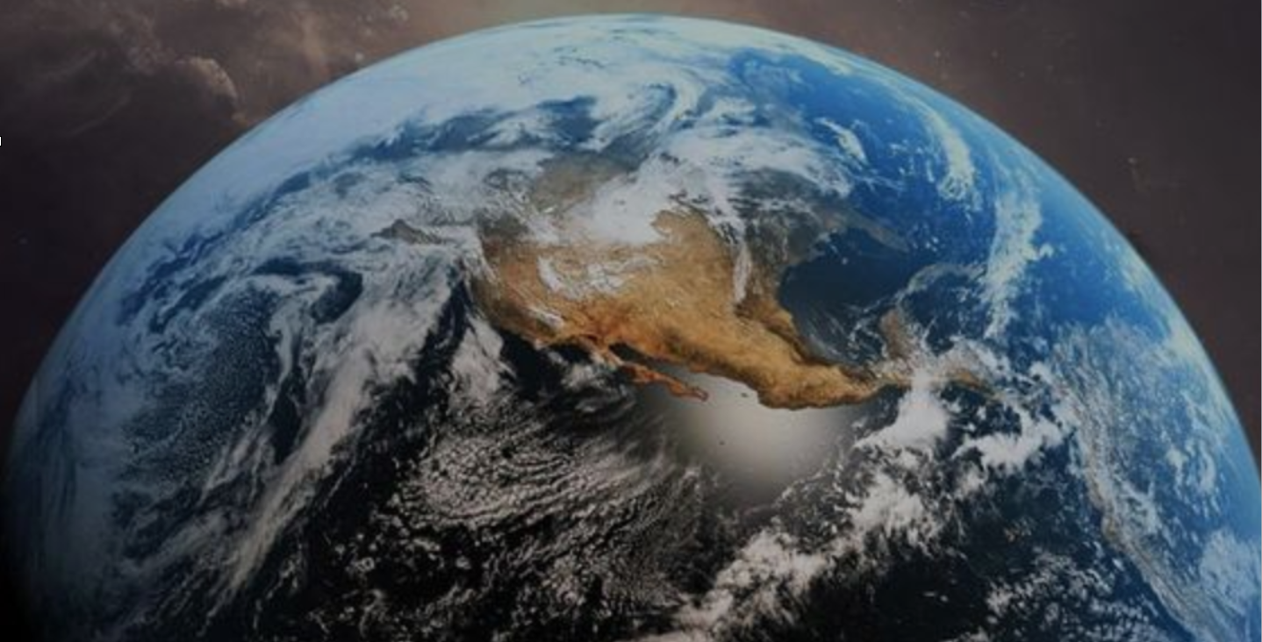
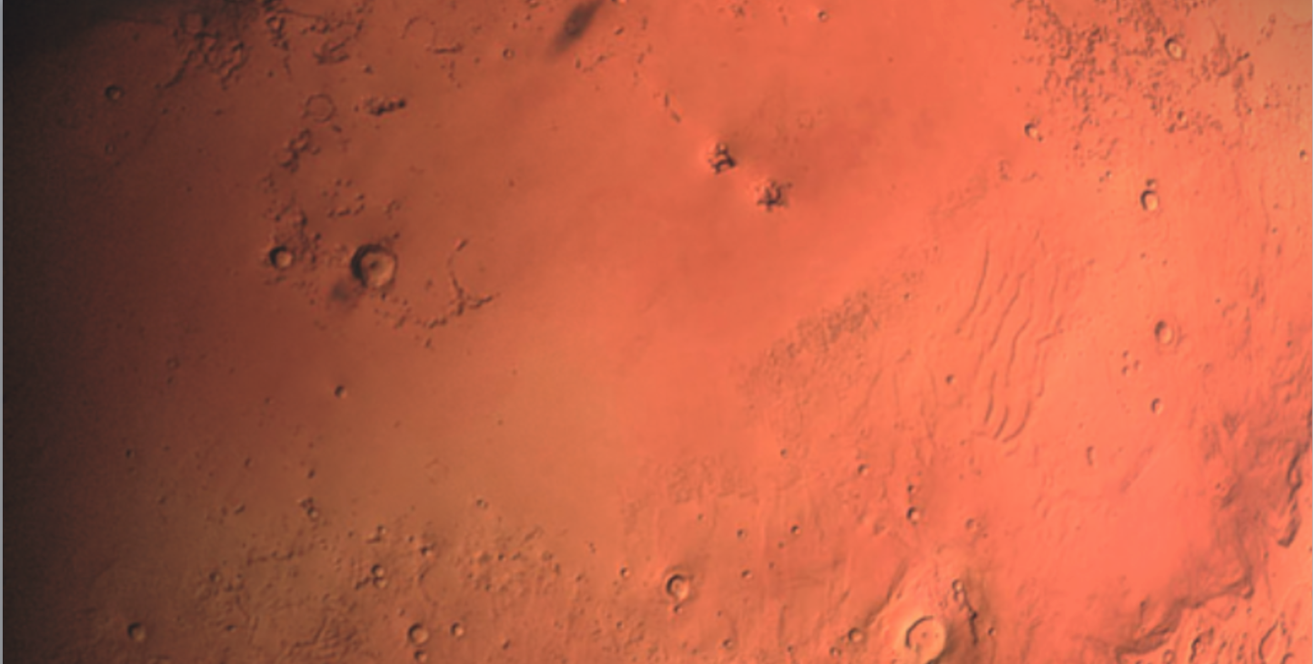
GS@HackTheSolarSystem
ZEPHYR
Partly Cloudy Skies on Earth and Mars

Slide 2
What did we do?
Real-Time Data Visualization on OpenSpace
OnDemand Data Visualization on OpenSpace

Slide 3
Working Prototype
Image Recorder
Image Processor
Image Transformer
Image Store
Real-time Visualization
On-demand Interface
Pull request
OpenSpace

Slide 4
Follow the Globe

Slide 5
Follow Hurricane Michael

Slide 6



If we had more time….
Dataset Caching
Large Datasets hosting/streaming from a Server
Hadoop Integration for reliable large data processing , high-bandwidth streaming

Slide 7
What were the main challenges?
OpenSpace installations
Conda GDAL / Py GDAL didn’t pair well

Slide 8
What we learnt…
OpenSpace
Geo spatial dataset visualization
Technology impact on science challenges

Slide 9
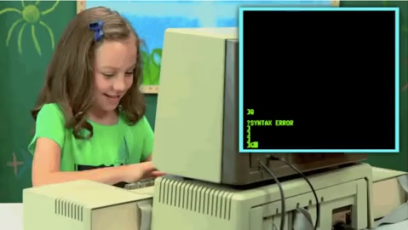
Thank you…
..and a happy Hacker

